Slide 1
The prerequisites to find personal meaning - grounded on the structure of existence -
Längle Alfried, M.D., Ph.D. International Society for Logotherapy and Existential Analysis, Vienna www.laengle.info / www.existential-analysis.org

Slide 2
Agenda
Existential Analysis (Vienna)
What is meaning?
Inner consent as access to meaning
Existence and personal meaning
Practical steps for personal meaning
Existential meaning – specifically
The purpose of Meaning

Slide 3
1. Existential Analysis (Vienna)
= a phenomenological approach …
…. of being a person in one’s world

Slide 4
Existential Analysis (Vienna)
phenomenological approach
of being a person in one’s world
→ aim:
to help people to live with
inner consent

Slide 5
2.) What is meaning?
Questions…
What is meaning?
How to live meaningfully?
Meaning in life?
Purpose and meaning of life?
…

Slide 6
2. What is meaning?
Questions…
How to live meaningfully?
Meaning in life?
Purpose and meaning of life? …
→ Meaning must contain a content,
a „what for“ – a felt value in the situation

Slide 7
2. What is meaning?
Terms:
Meaning = understanding of the content
Purpose = direction to the content
Sense = feeling for the obviousness and value of the conten

Slide 8
2. What is meaning?
How to live meaningfully?
Meaning in life?
Purpose and meaning of life?
The content = a felt value
The practical aspect:
Meaning in life = to live with inner consent

Slide 9
3.) Inner consent as access to meaning
Why does inner consent open the way to meaning?

Slide 10
3.) Inner consent as access to personal meaning
Why does inner consent open the way to meaning?
What does „inner consent“ mean?

Slide 11
3.) Inner consent….
Inner consent…
= an inner „yes“ for going into a situation
- Is free
- Is felt: con-“sent“

Slide 12
3.) Inner consent….
Inner consent…
= an inner „yes“ for going into a situation
Accepting the conditions

Slide 13
3.) Inner consent….
Inner consent…
= an inner „yes“ for going into a situation
Accepting the conditions
Turning towards the value

Slide 14
3.) Inner consent….
Inner consent…
= an inner „yes“ for going into a situation
Accepting the conditions
Turning towards the value
Seeing my own and what is right

Slide 15
3.) Inner consent….
Inner consent…
= an inner „yes“ for going into a situation
Accepting the conditions
Turning towards the value
Seeing my own and what is right
According with the greater context and future

Slide 16
4. Existence and personal meaning
The place of meaning within existence –
existence means more than just the realization of meaning

Slide 17
4.) Existence and personal Meaning
The four fundamental realities (dimensions):
the world in its facts & possibilities

Slide 18
The four fundamental realities (dimensions):
the world in its facts & possibilities
life with its network of relationships and feelings

Slide 19
4.) Existence and personal Meaning
The four fundamental realities (dimensions):
the world in its facts & possibilities
life with its network of relationships and feelings
being oneself as a unique, autonomous, responsible person

Slide 20
4.) Existence and personal Meaning
The four fundamental realities (dimensions):
the world in its facts & possibilities
truth
life with its network of relationships and feelings
value
being oneself as a unique, autonomous, responsible person
the wider context: the future (“becoming” through one’s activities and engagement)
⇨ meaning

Slide 21
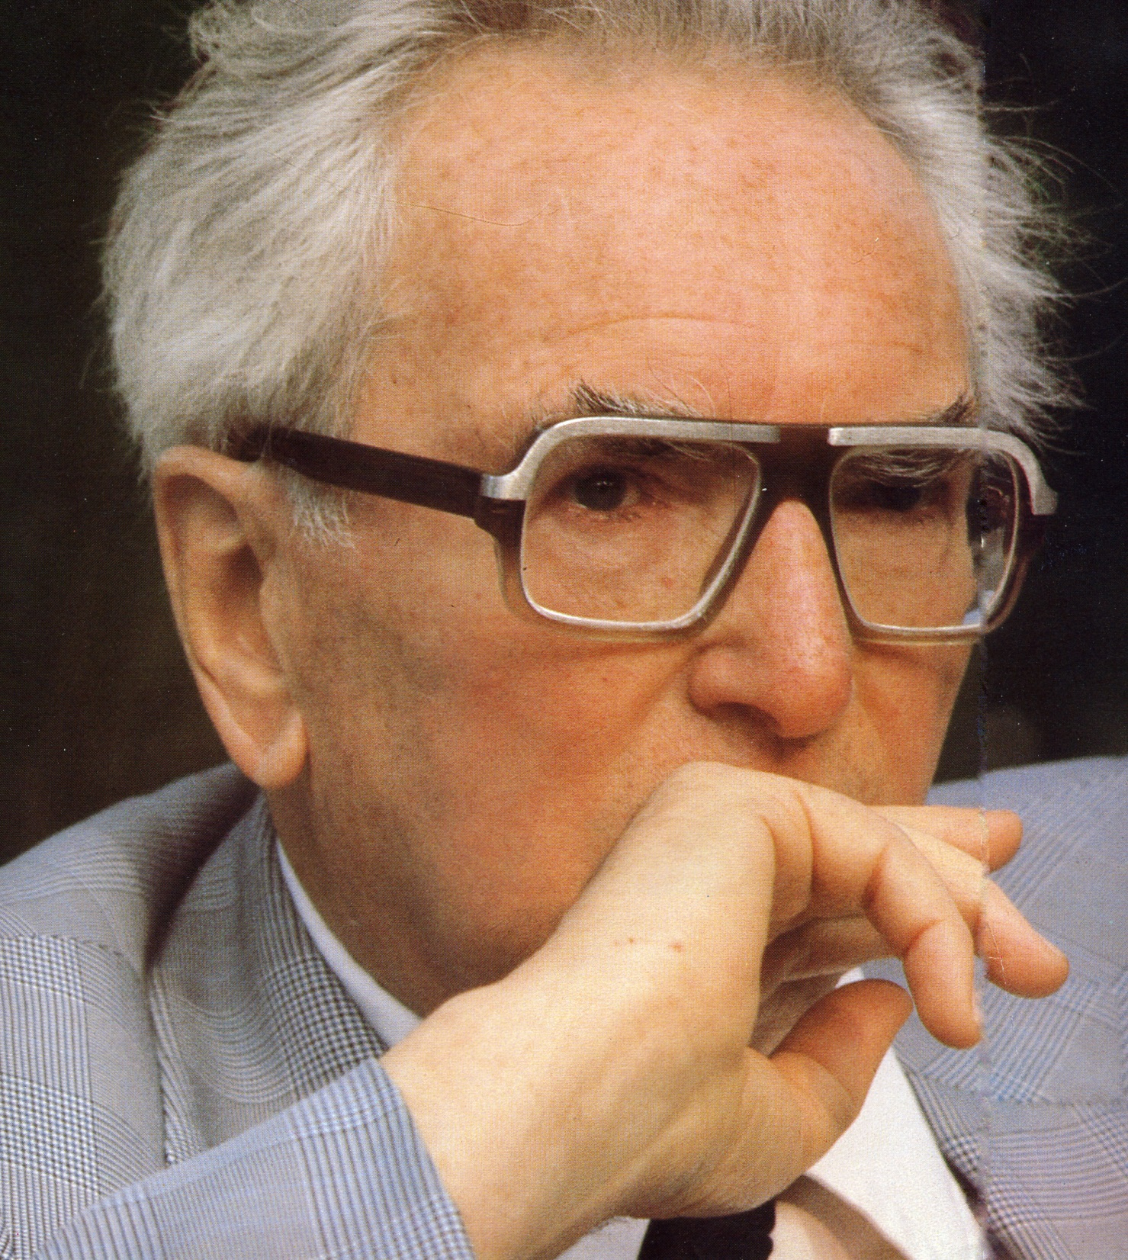
4.) Existence and personal Meaning
Key for discovering meaning
the “Existential Turn”
(V. Frankl, 1946)

Slide 22
4.) Existence and personal Meaning
Questioning
Responding
ME „World“
Person
Being-in-the-World
Other(s),
YOU
Dialogical reality of existence

Slide 23
5. Practical steps
for finding existential meaning according to the
Fundamental Existential Motivations
Works with inner consent
and the 4 dimensions of existence

Slide 24
5. Practical steps
1st Element: capacities and possibilities
What can I do – what am I able to do in this situation?
→ capacities, power and possibilities

Slide 25
5. Practical steps
1st Prerequisite = acceptance:
„I can let it be – because it lets me be“.
Needs courage, support.
Allows trust.

Slide 26
5. Practical steps
2nd Element: connecting emotionally
What do I like to do? – What do I feel of being worthy?
→ feelings and values

Slide 27
5. Practical steps
2nd Prerequisite: Turning towards
Inner resonance, let come inside all what nurtures life (in analogy to food, water, air) –
instead of remaining distant, separated, cold, untouched, functional, not relational.

Slide 28
5. Practical steps
2nd Turning towards:
Develop and caring of relationships, pleasure, closeness, to make life valuable.

Slide 29
5. Practical steps
3rd Element: connecting with my interest and ethics
What may I do? – What corresponds to me in this situation? What is right here?
→ authenticity and ethics

Slide 30
5. Practical steps
3rd Prerequisite: Looking at
Delimitate from others, set your boundaries, encounter the essence the essential („my real own“), sensing the right –
instead of prejudices, manipulation.

Slide 31
5. Practical steps
3rd Looking at:
Development of decisiveness, genuinness, responsibility, appreciation, to be able to encounter authentically.

Slide 32
5. Practical steps
4th Element: transcending one‘s life towards a greater context
What should (ought) I do? = to deal with the future.
= work at the tuning with the situation
→ openness to the world and meaning

Slide 33
5. Practical steps
4th Prerequisite: Tuning in, according with context and future
Dialogical exchange, openness for the needed & the offered (values) –
bracketing programs, fixe aims, goals and rigid plans.
Developing flexibility, adjustment, orientation, for finding meaning.

Slide 34
5. Practical steps
EXISTENCE
= Will (inner consent)
SHOULD
CAN
LIKE
MAY
4. Openness to
MEANING-connections:
situational +
fundamental
2. To feel the
value of LIFE
1. To connect with the
WORLD:
„I exist“, „I am able to be“
3. PERSON =
to be oneself, a unique being: to sense/experience authenticity

Slide 35
5. Practical steps
Criterion for a „full“, meaningful existence:
To experience inner fulfillment

Slide 36
6. Existential Meaning specifically

Slide 37
6. Existential Meaning specifically
Existential Meaning …
… is fulfilled through the
realization of values
(V. Frankl, 1984, 202)

Slide 38
6. Existential Meaning specifically
Meaning alignment with a value
value
Meaning

Slide 39
6. Existential Meaning specifically
“Mainroads to existential meaning”
(V. Frankl, 1946; 1973, 43f)
1. Experiential values

Slide 40
6. Existential Meaning specifically
Three categories for discovering meaning according to Frankl:
1. Experiential values
2. Creative values

Slide 41
6. Existential Meaning specifically
Three categories for discovering meaning according to Frankl:
1. Experiential values
2. Creative values
3. Attitudinal values

Slide 42
6. Existential Meaning specifically
Basic principle of Existential Analysis (EA):
…Dialogical exchange
with oneself and others

Slide 43
6. Existential Meaning specifically
Inner world
Outer world
I
Person
Person stands in continuous inner and outer dialogue

Slide 44
6. Existential Meaning specifically
Existential Meaning is defined as:
“… a valuable task – challenge – possibility …
within my actuality“ V. Frankl 1985, 42

Slide 45
7. The Purpose of Meaning

Slide 46
7. The purpose of Meaning
Personal Meaning
to open up for otherness
(for a real „being in the world“)

Slide 47
7. The purpose of Meaning
Personal Meaning
a) to open up for otherness
b) and to „become more myself“
(to find oneself in the dialogue with the world)

Slide 48
7. The purpose of Meaning
Personal Meaning
a) to open up for otherness
b) to „become more myself“
c) to transcend the time (moment) to a future
(to be directed towards a value in the future = from being to becoming)

Slide 49
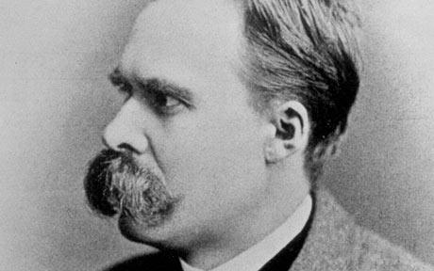
7. The purpose of Meaning
Power of meaning
He who has a why to live for
– can bear almost any how.
(F. Nietzsche – wording of V. Frankl 1963, 164)

Slide 50
Thank You
Längle Alfried, M.D., Ph.D. International Society for Logotherapy and Existential Analysis, Vienna www.laengle.info / www.existential-analysis.org

